Slide 1
Hotel Reservation Analysis with SQL
– by Karunakar Cheekolu

Slide 2
Given dataset - Hotel Reservation
Dataset Details:
The dataset includes the following columns:
Booking_ID: A unique identifier for each hotel reservation.
no_of_adults: The number of adults in the reservation.
no_of_children: The number of children in the reservation.
no_of_weekend_nights: The number of nights in the reservation that fall on
weekends.
no_of_week_nights: The number of nights in the reservation that fall on
weekdays.

Slide 3
type_of_meal_plan: The meal plan chosen by the guests.
room_type_reserved: The type of room reserved by the guests.
lead_time: The number of days between booking and arrival.
arrival_date: The date of arrival.
market_segment_type: The market segment to which the reservation
belongs.
avg_price_per_room: The average price per room in the reservation.
booking_status: The status of the booking.

Slide 4

What is the total number of reservations in the dataset?
SELECT COUNT(*) AS total_reservations FROM htable;

Slide 5
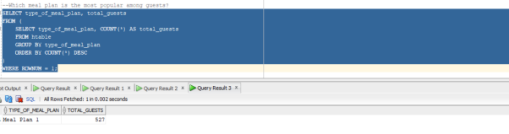
2. Which meal plan is the most popular among guests?
SELECT type_of_meal_plan, total_guests
FROM (
SELECT type_of_meal_plan, COUNT(*) AS total_guests FROM htable
GROUP BY type_of_meal_plan
ORDER BY COUNT(*) DESC)WHERE ROWNUM = 1;

Slide 6
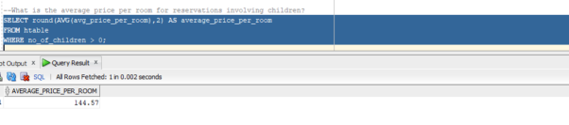
3. What is the average price per room for reservations involving children?
SELECT round(AVG(avg_price_per_room),2) AS average_price_per_room
FROM htable
WHERE no_of_children > 0;

Slide 7
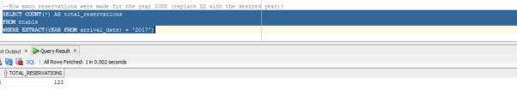
4. How many reservations were made for the year 20XX (replace XX with the desired year)?
SELECT COUNT(*) AS total_reservations
FROM htable
WHERE EXTRACT(YEAR FROM arrival_date) = '2017';

Slide 8
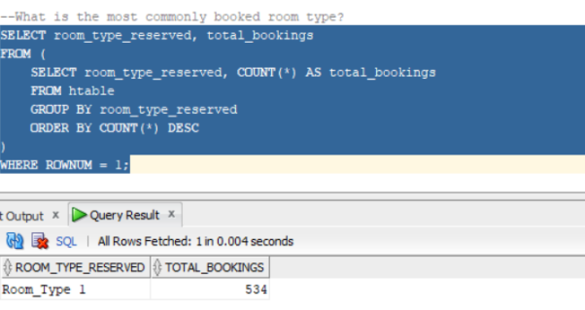
5. What is the most commonly booked room type?
SELECT room_type_reserved, total_bookings
FROM (
SELECT room_type_reserved, COUNT(*) AS total_bookings
FROM htable GROUP BY room_type_reserved
ORDER BY COUNT(*) DESC)WHERE ROWNUM = 1;

Slide 9
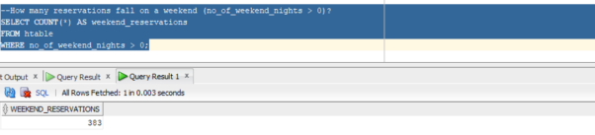
6. How many reservations fall on a weekend (no_of_weekend_nights > 0)?
SELECT COUNT(*) AS weekend_reservations
FROM htable WHERE no_of_weekend_nights > 0;

Slide 10
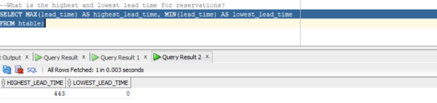
7. What is the highest and lowest lead time for reservations?
SELECT MAX(lead_time) AS highest_lead_time, MIN(lead_time) AS lowest_lead_time
FROM htable;

Slide 11
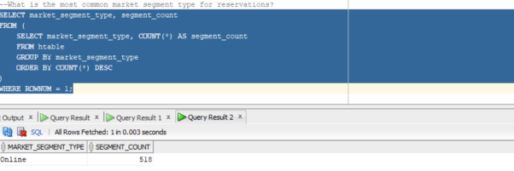
8. What is the most common market segment type for reservations?
SELECT market_segment_type, segment_count
FROM ( SELECT market_segment_type, COUNT(*) AS segment_count
FROM htable GROUP BY market_segment_type
ORDER BY COUNT(*) DESC )WHERE ROWNUM = 1;

Slide 12
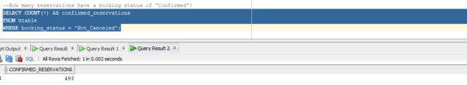
9. How many reservations have a booking status of "Confirmed"?
SELECT COUNT(*) AS confirmed_reservations
FROM htable WHERE booking_status = 'Not_Canceled';

Slide 13
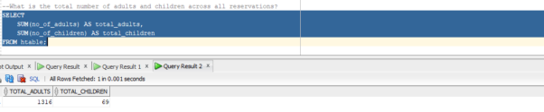
10. What is the total number of adults and children across all reservations?
SELECT SUM(no_of_adults) AS total_adults,
SUM(no_of_children) AS total_children FROM htable;

Slide 14
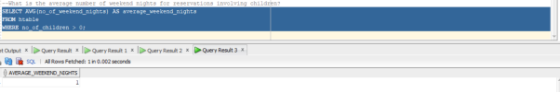
11. What is the average number of weekend nights for reservations involving children?
SELECT AVG(no_of_weekend_nights) AS average_weekend_nights
FROM htable WHERE no_of_children > 0;

Slide 15
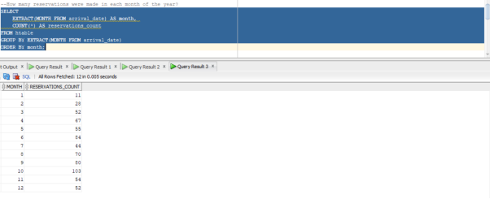
12. How many reservations were made in each month of the year?
SELECT EXTRACT(MONTH FROM arrival_date) AS month, COUNT(*) AS reservations_count
FROM htable GROUP BY EXTRACT(MONTH FROM arrival_date) ORDER BY month;

Slide 16
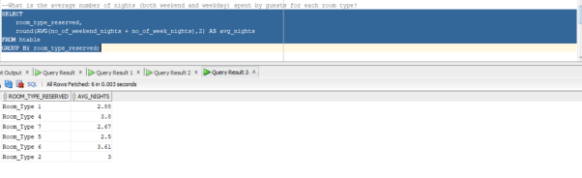
13. What is the average number of nights (both weekend and weekday) spent by guests for each room type?
SELECT room_type_reserved, round(AVG(no_of_weekend_nights + no_of_week_nights),2) AS avg_nights FROM htable GROUP BY room_type_reserved;

Slide 17
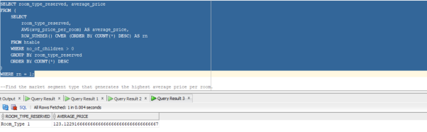
14. For reservations involving children, what is the most common room type, and what is the average price for that room type?
SELECT room_type_reserved, average_price FROM ( SELECT room_type_reserved,
AVG(avg_price_per_room) AS average_price, ROW_NUMBER() OVER (ORDER BY COUNT(*) DESC) AS rn FROM htable WHERE no_of_children > 0 GROUP BY room_type_reserved ORDER BY COUNT(*) DESC ) WHERE rn = 1;

Slide 18
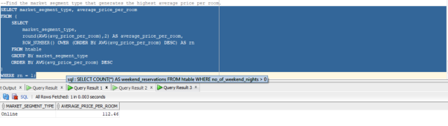
15. Find the market segment type that generates the highest average price per room.
SELECT market_segment_type, average_price_per_room
FROM ( SELECT market_segment_type, round(AVG(avg_price_per_room),2) AS average_price_per_room, ROW_NUMBER() OVER (ORDER BY AVG(avg_price_per_room) DESC) AS rn FROM htable GROUP BY market_segment_type
ORDER BY AVG(avg_price_per_room) DESC ) WHERE rn = 1;

Slide 19
Thank You

